Slide 1

Android Developer Virtual Internship
by
K.RASHMI
Roll No : 224G1A3379
Department of Computer Science and Engineering (AI&ML)
Srinivasa Ramanujan Institute of Technology
Autonomous
Rotarypuram Village, B K Samudram Mandal, Ananthapuramu – 515701.
2023-2024

Slide 2

Contents
Course Objective
Introduction to Android
Course Structure
Advantages & Disadvantages
Learning Outcomes
Certificate

Slide 3
Course Objective
The Main objective of the Google Android Developer course is to equip you with the skills to design, build, and deploy high-quality Android applications, preparing you for a successful career in mobile app development.
Learn to build Android apps using modern tools like Android Studio, Jetpack Compose, and Material Design.
Gain a solid understanding of Kotlin programming, essential for Android development.
Create intuitive and responsive UIs that enhance user experience.
Apply best practices in app architecture, data handling, and persistence using tools like Room and APIs.
Apply skills in real-world projects, preparing you for a professional career in Android development.

Slide 4

Introduction to Android
Android is a mobile operating system developed by Google, it is used for touch screen devices like smartphones and tablets.
It has a user-friendly interface and within the interface we can perform various tasks and it has wide range of apps and features.
As of now, Android OS is being used on 2.5 billion devices worldwide.
Android was invented by Andy Rubin, Rich Miner, Nick Sears, and Chris White, who founded Android Inc. in 2003. The company was acquired by Google in 2005, which further developed the operating system. The first commercial version, Android 1.0, was released in 2008.
The current version of Android as of 2024 is Android 14, codenamed "Upside Down Cake." It was publicly released on October 4, 2023​ (Talk Android)​.

Slide 5
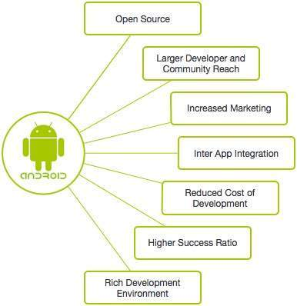
Contd..
Features:
Beautiful UI
Media support
Multi-tasking
Wi-Fi Direct
Applications:
E-Commerce Apps:
Amazon, Flipkart
Social Media Apps:
Instagram, LinkedIn
Entertainment Apps:
Netflix, Hotstar
Productivity Apps:
Google docs, Microsoft Teams

Slide 6
Course Structure
Unit 1: Your first Android app
Unit 2: Building app UI
Unit 3: Display lists and use Material Design
Unit 4: Navigation and app architecture
Unit 5: Connect to the internet
Unit 6:Data Persistence
Unit 7: Views and Compose

Slide 7
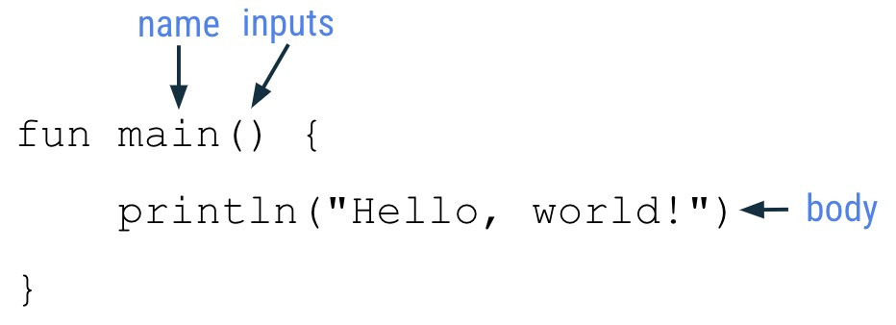
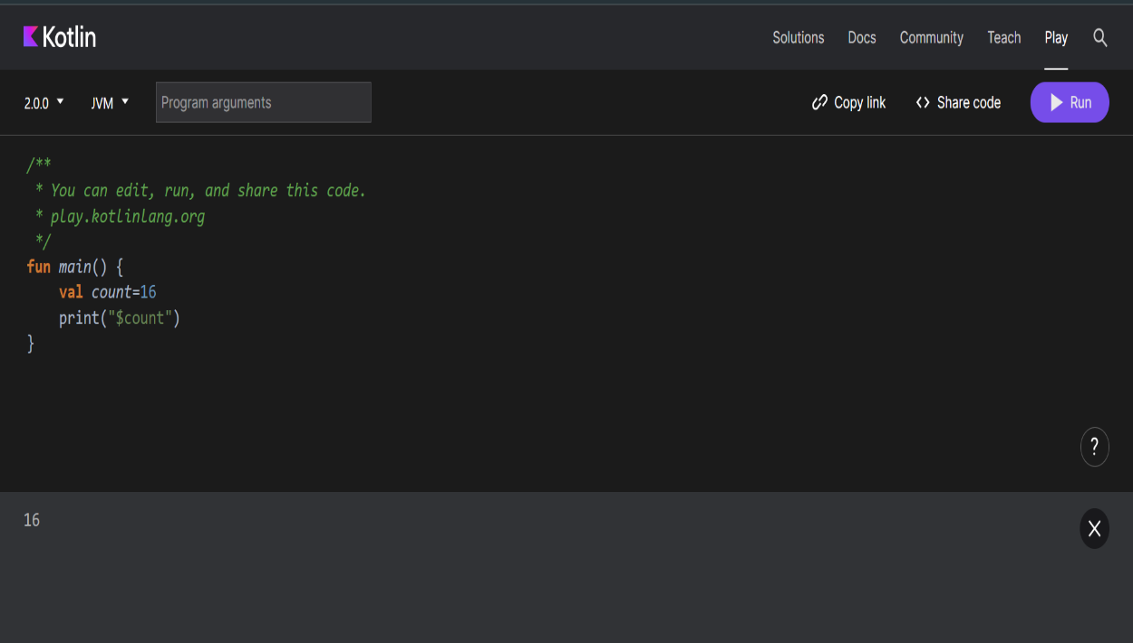
Unit-1: Your First Android App
Introduction to Kotlin:
Kotlin is a modern, statically typed programming language that runs on the Java Virtual Machine (JVM) and can also be compiled to JavaScript or native code. It was Announced by JetBrains in 2011.
In 2016 first stable release and in 2019 Google named and preferred Kotlin language for App development over Java.

Slide 8
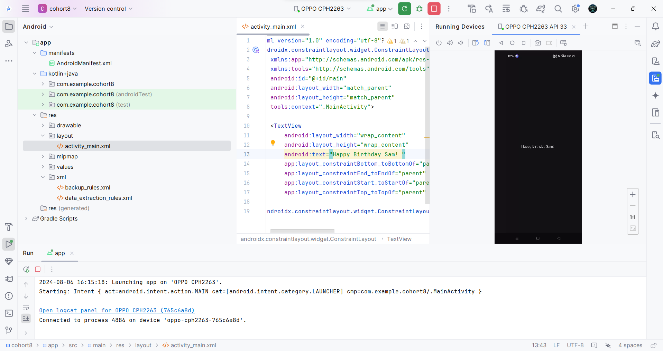
Contd..
Setup Android Studio and Build a Basic Layout

Slide 9
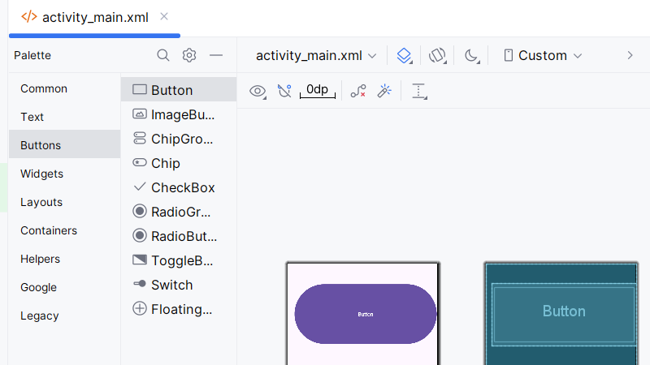
Unit 2 :Building App UI
Kotlin Fundamentals:
In Kotlin language the fundamentals contain conditional statements, looping statements, classes and objects, nullability, lambda expressions.
This language is interoperable with java.
Add a button to an app:
To add a button to an app click on the ‘button’ and enter then a button is added.

Slide 10
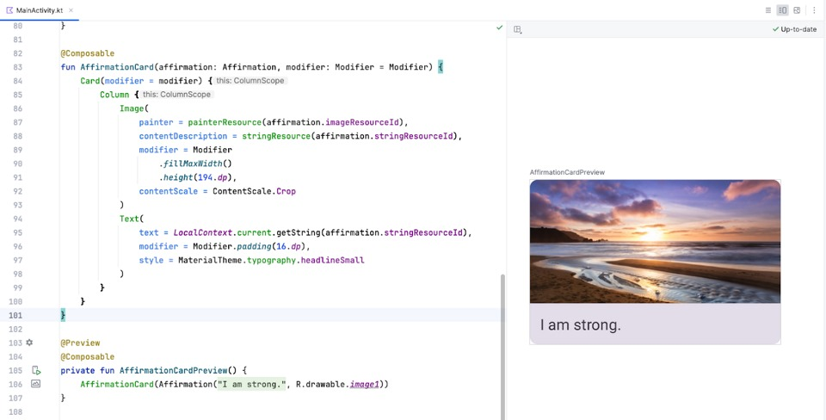
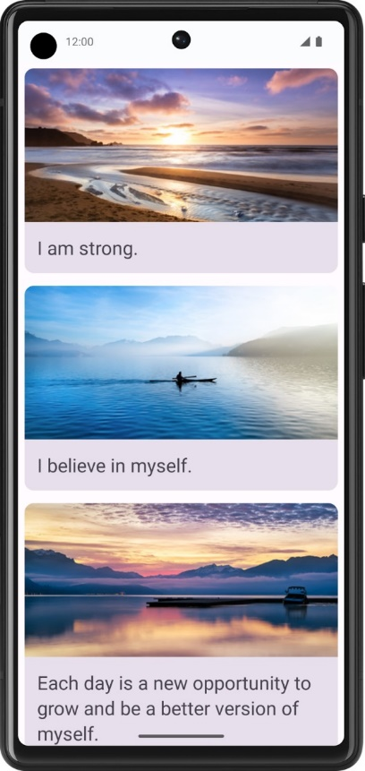
Unit 3: Display Lists & use Material Design
Build a scrollable list
To create a list of affirmations in your app, use the Card composable to display each affirmation. Inside the Card, include an Image and a Text composable. The Card acts as a surface, grouping the Image and Text together in a single container. To display multiple affirmations, add these Card components to a list and render them all within your app.

Slide 11
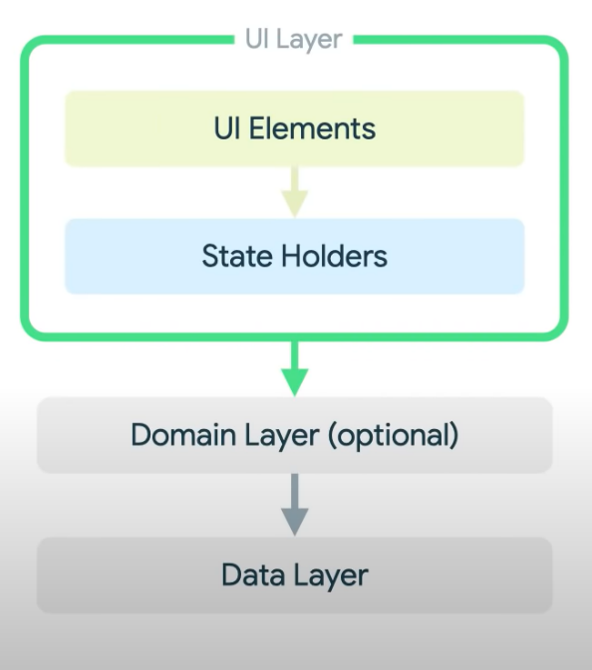
Unit 4: Navigation and App Architecture
Architecture Components
The role of the UI is to display the application data on screen, and to serve as the primary point of user interaction.
What is UI ?
UI Elements + UI state = UI
UI Elements: The visual components of an interface, such as
buttons, text fields, and icons
. UI State: The current condition or data of the UI elements, like
whether a button is enabled or the text in a field.
State Holders : State Holders come in a variety of shapes and sizes depending on the UI elements that produce state for screens, activities, fragments or navigation destinations, a view model instances is typically the primary state holder.
Data Link Layer: It sends user data to application

Slide 12
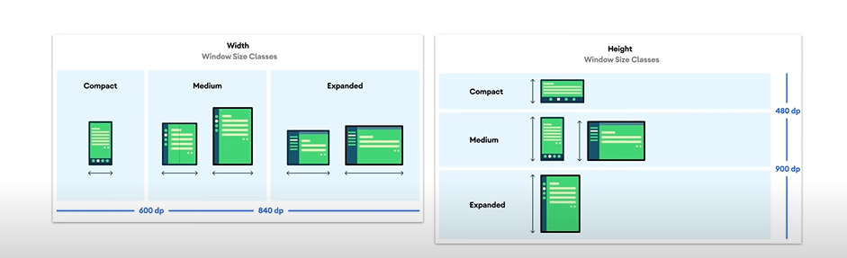
Contd..
Navigation in Jetpack Compose
Navigation is managed using NavHost & NavController components that handles transitions between screens.
NavHost : It is a container that manages and displays navigation screens of your app.
NavController : It handles navigation operations(Switching Screens) within the NavHost
Adapt For Different Screen Size
Adaptive layouts are layouts that change in shape, dimensions, and content, reacting to input from users, devices, and screen elements

Slide 13
UNIT 5: Connect to Internet
Get Data From The Internet:
Use Coroutines: Run network tasks in the background to keep your app responsive.
Learn HTTP and REST: Understand HTTP for web communication and REST for using standard methods like GET and POST
HTTP Methods: GET to retrieve, POST to send, PUT to update, and DELETE to remove data.
REST Principles: Use simple, stateless communication and clear resource URLs.
Load and display images from the internet:
To load and display images from the internet in your app:
Use Coroutines: Handle network operations in the background.
Choose a Library: Use Coil or Glide or Picasso to simplify image loading and caching.
Fetch Images: Load images from URLs using Coil.
Display Images: Set the fetched images into your app’s image views.
This approach ensures efficient image handling and a smooth user experience.

Slide 14
Unit 6: Data Persistence
Introduction to Databases and SQL:
SQL (Structured Query Language) is a powerful language used to interact with relational databases. In relational database management systems (RDBMS), SQL is used to perform various operations: SELECT, INSERT, UPDATE, DELETE, WHERE, JOIN, GROUP BY, ORDER BY. These SQL operations facilitate effective data management and manipulation in RDBMS.
SQL transactions manage a series of actions as a single unit BEGIN,COMMIT,ROLLBACK. This ensures either all operations perform or none are applied.
Use Room for data persistence
Room is preferred for data persistence because it simplifies SQLite database management with an easy API, automates setup, and offers compile-time validation of SQL queries.
It integrates seamlessly with Android Jetpack components, supports LiveData and coroutines, and enhances development efficiency and safety

Slide 15
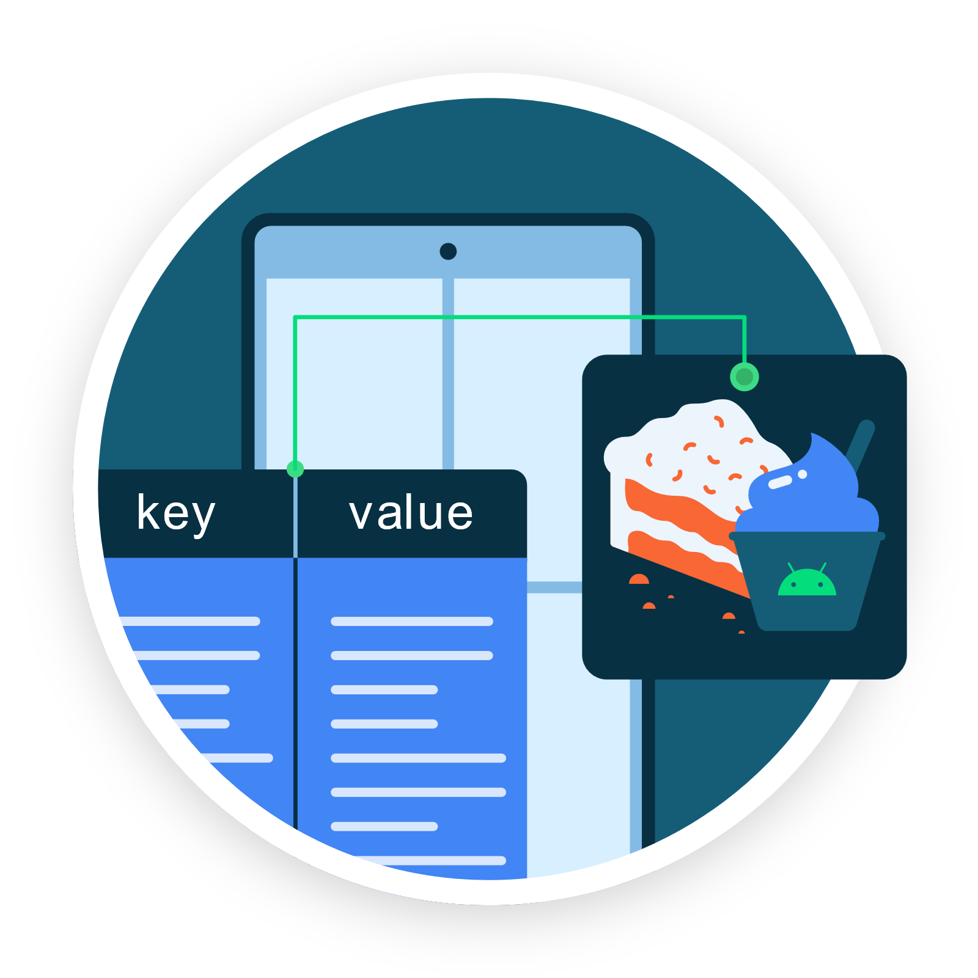
Contd…
Store and access data using keys with DataStore
DataStore is a modern data storage solution introduced by Google to
replace Shared Preferences.
It has two mechanisms:
Preference DataStore
Proto DataStore
Shared Preferences is an older Android method for storing small amounts of data as key-value pairs, where data is saved synchronously, meaning it can block the main thread and potentially affect app performance.
DataStore uses asynchronous operations, which means it performs data read and write tasks in the background, preventing the main thread from being blocked and improving app performance and responsiveness.

Slide 16
Unit 7: Views and Compose …
Android Views and Compose in Views
Learning about Android Views involves using XML layouts and UI components like Text Views and Buttons to build interfaces. To create an app, set up Android Studio, design layouts in XML, and develop activities and fragments with Java or Kotlin. Integrate modern Jetpack Compose components for hybrid UIs, then test, debug, and deploy your app.
Compose in Views: Refers to the ability to integrate or use traditional Android Views (defined in XML) within a Compose-based UI. This approach allows you to use existing View-based components and layouts alongside Composes declarative UI elements.
Views in Compose
In Android development, "Views" are UI elements defined in XML files such as activity_main.xml, fragment_layout.xml, and widget_layout.xml. These files can be edited in Android Studio. You can preview and test these Views on a device through USB or wireless debugging.

Slide 17
Advantages & Disadvantages
Advantages
Ease of Communication
Open source
User friendly
Can be used offline
Disadvantages
Hard to Create
Difficulty in marketing
Security
Frequent Updates Are Required

Slide 18
Learning Outcomes
Proficiency in Java/Kotlin: Mastery of primary programming languages for Android.
UI/UX Design: Ability to create user-friendly and visually appealing interfaces.
Android SDK and Components: Knowledge of key Android components and libraries.
Testing and Debugging: Skills in testing, debugging, and optimizing app performance.

Slide 19
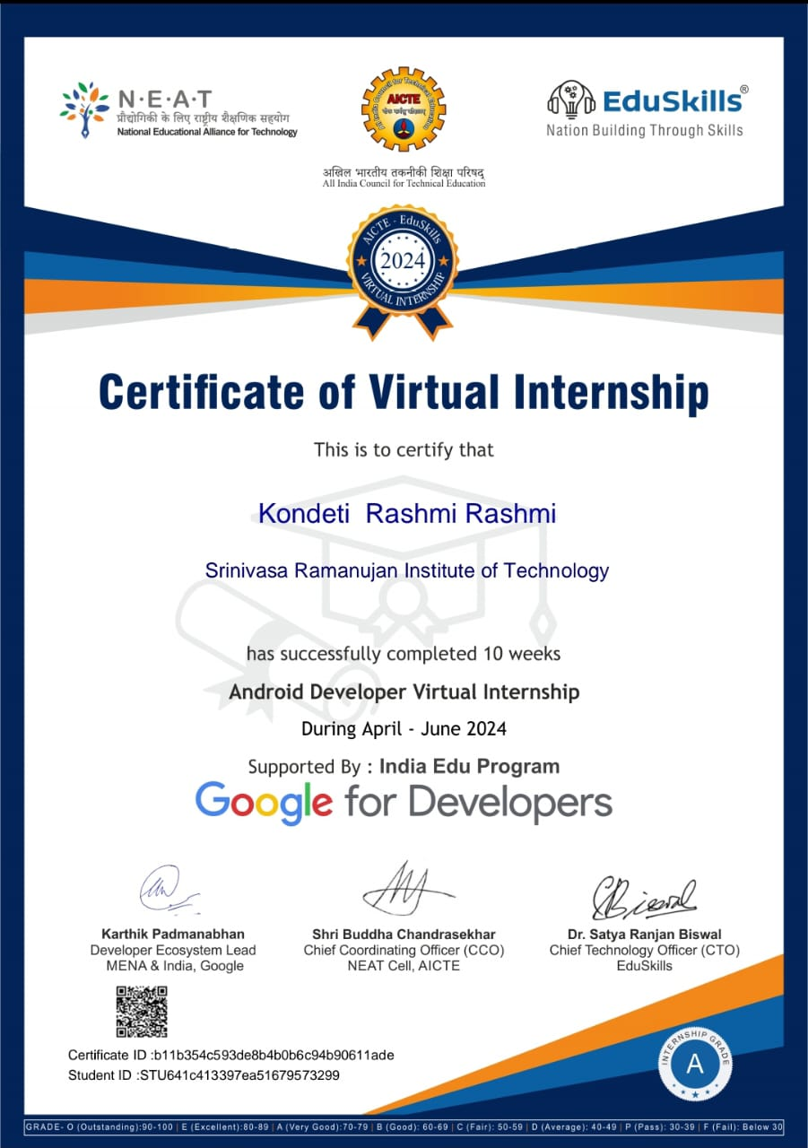
Certificate

Slide 20
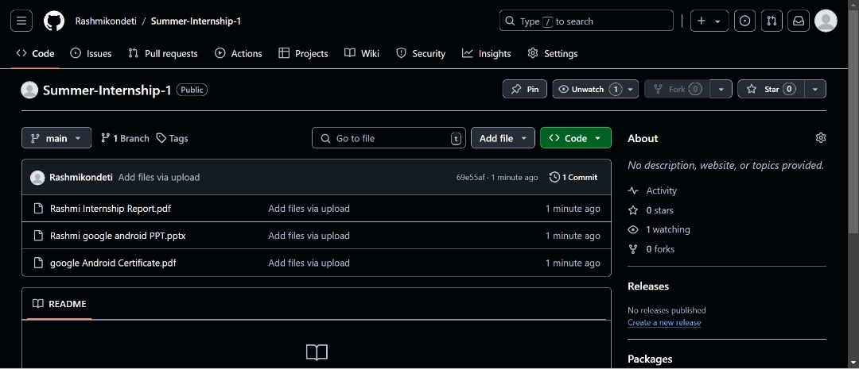
Github Dashboard

Slide 21
Thank You!!!

